Slide 1
Deep Learning Final Project
CycleGAN & UNet Semantic Segmentation
By: Qianzhe (Jason) Wang

Slide 2
CycleGAN Architecture
S
Generator1 (S2W)
G1 (W)
Discriminator1
Discriminator2
G2(G1(S))
Generator2(W2S)
Generator1 (S2W)
G1(G2(W))
Discriminator1
G2 (S)
Generator2 (W2S)
W
Discriminator2

Slide 3
Highlights
Identify mapping is added to the model architecture
Discriminator outputs real/fake labels at region level for an image
Each convolutional layer has ‘“same” padding, followed by instance normalization and leaky relu activation to prevent vanishing gradient
Model loss is consisted of adversarial loss (MSE), identity loss(MAE) and cycle loss (MAE, given most weight)
Take summer to winter cycle as an example:
Adversarial loss: S -> Generator W -> W -> Discriminator W -> [real/fake]
Identity loss: W -> Generator W -> W
Forward cycle loss: S -> Generator W -> W -> Generator S -> S
Backward cycle loss: W -> Generator S -> S -> Generator W -> W

Slide 4
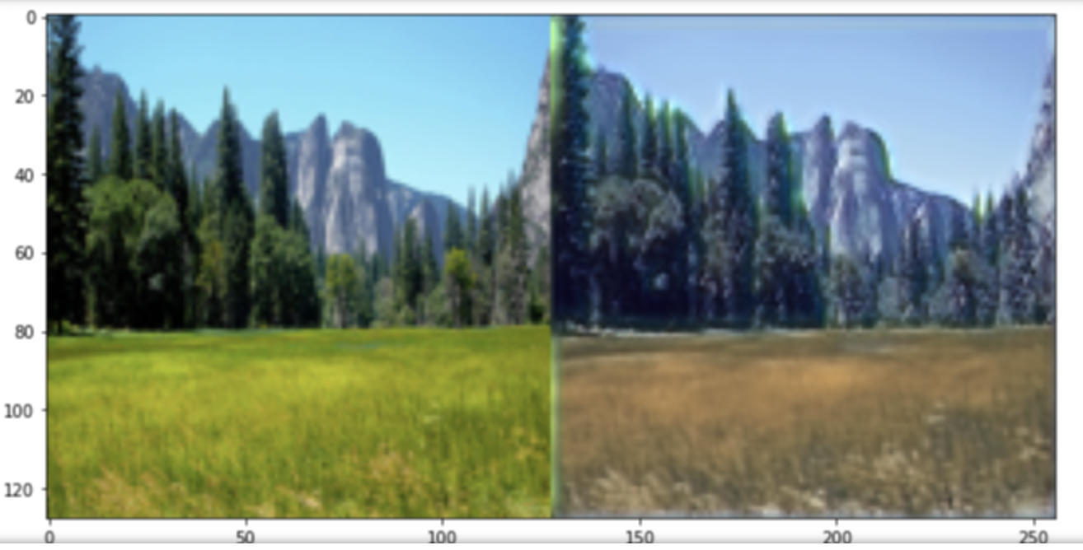
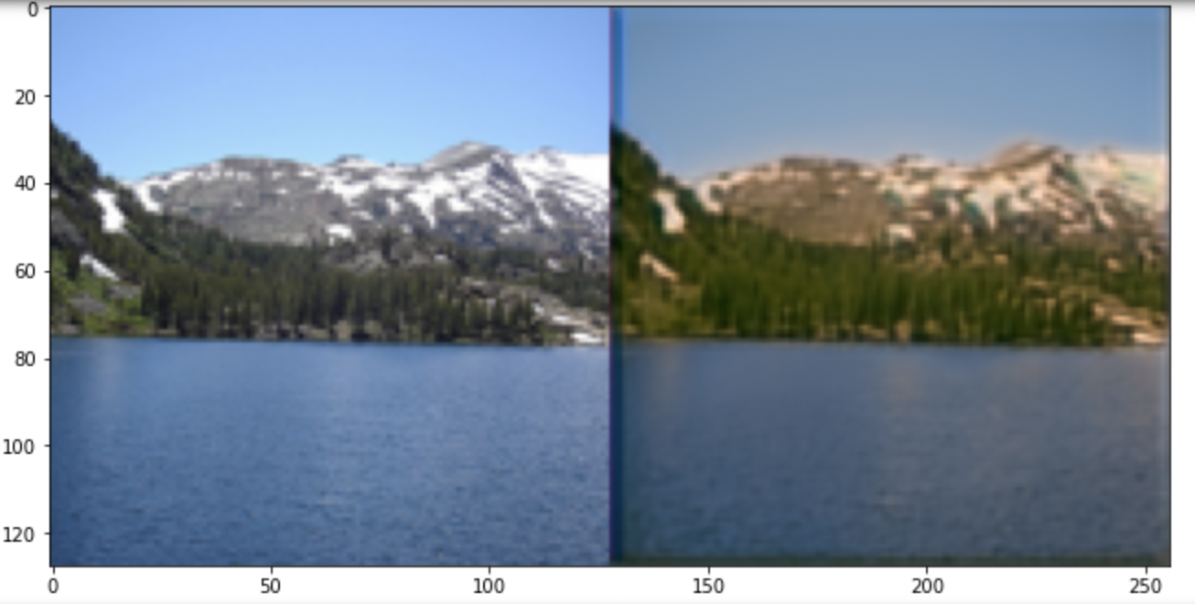
Model Results
To improve the performance:
Network can be made more complex
Model could be trained longer
More image preprocessing could be done

Slide 5
UNet Semantic Segmentation
Used a different image dataset that has labels from nine different classes keys
Applied one-hot-encoding to convert a 2D image label array into one-hot format and reverse one-hot encoding to transform the one-hot format image into a 2D array with only 1 channel, where each pixel value is the classified class key
Applied data augmentation and preprocessing transformations on the image dataset
Applied UNet segmentation model with ‘resnet50’ pretrained encoder and ‘imagenet’ encoder weights
Trained UNet model for about 50 epochs but can be trained longer for even better performance

Slide 6
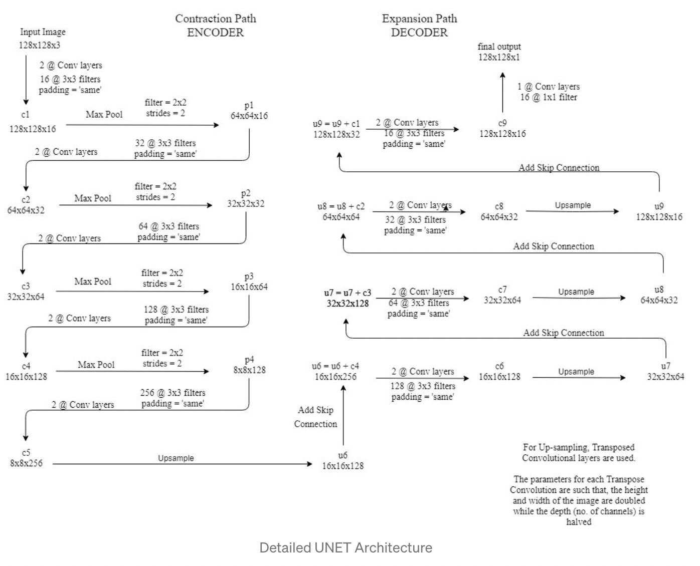
UNet Architecture

Slide 7
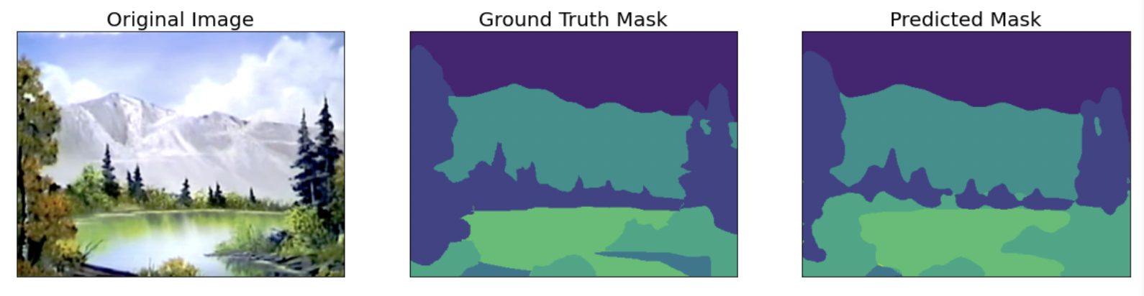
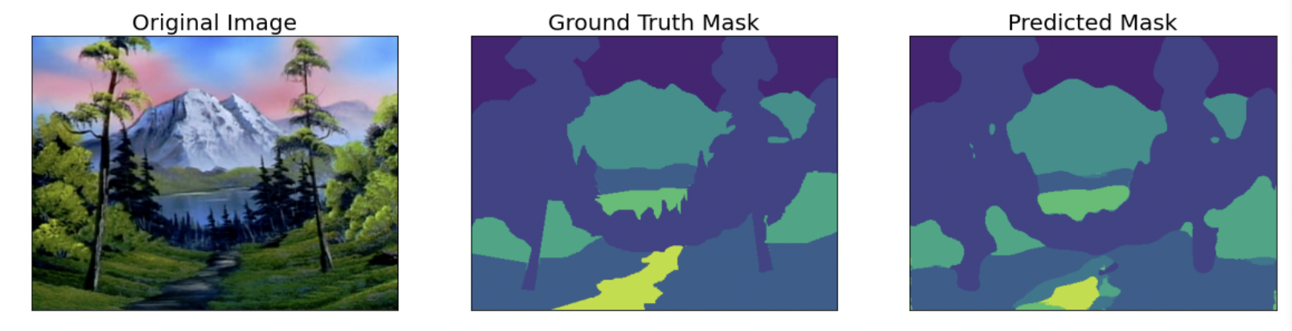
Model Results

Slide 8
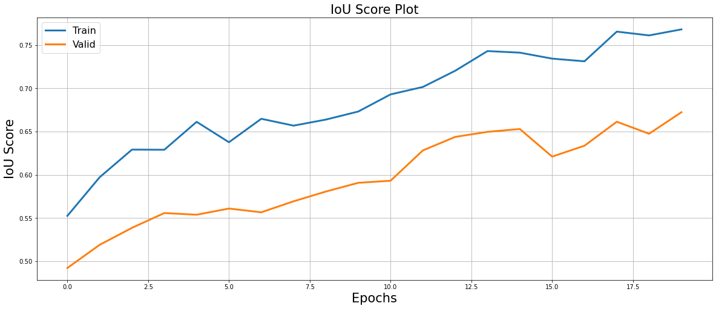
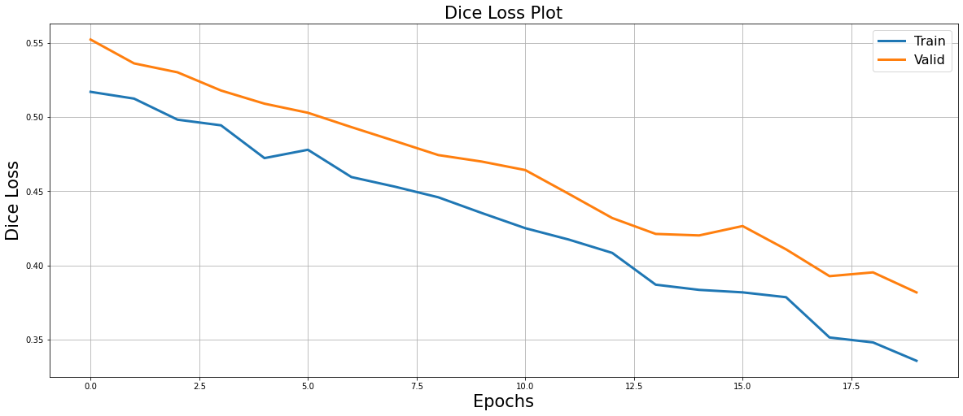
Model Results
Model could be trained longer for better performance

Slide 9
References
[1] Mehul Gupta. (2021, Sep 14) Understanding CycleGANs using examples & Codes. Retrieved from https://medium.com/data-science-in-your-pocket/understanding-cyclegans-using-examples-codes-f5d6e1a47048
[2] Balraj Asjwath. Summer2Winter Yosemite. https://www.kaggle.com/datasets/balraj98/summer2winter-yosemite
[3] Balraj Ashwath. UNet for Segmenting BobRoss Paintings. https://www.kaggle.com/code/balraj98/unet-for-segmenting-bob-ross-paintings-pytorch.
[4] Aleksey Bilogur. Segmented Bob Ross Paintings. Retrieved from https://www.kaggle.com/datasets/residentmario/segmented-bob-ross-images.
[5] Harshall Lamda. (2019, Feb 17) Understanding Semantic Segmentation with UNET. Retrived from https://towardsdatascience.com/understanding-semantic-segmentation-with-unet-6be4f42d4b47

Slide 10
The End

